Slide 1
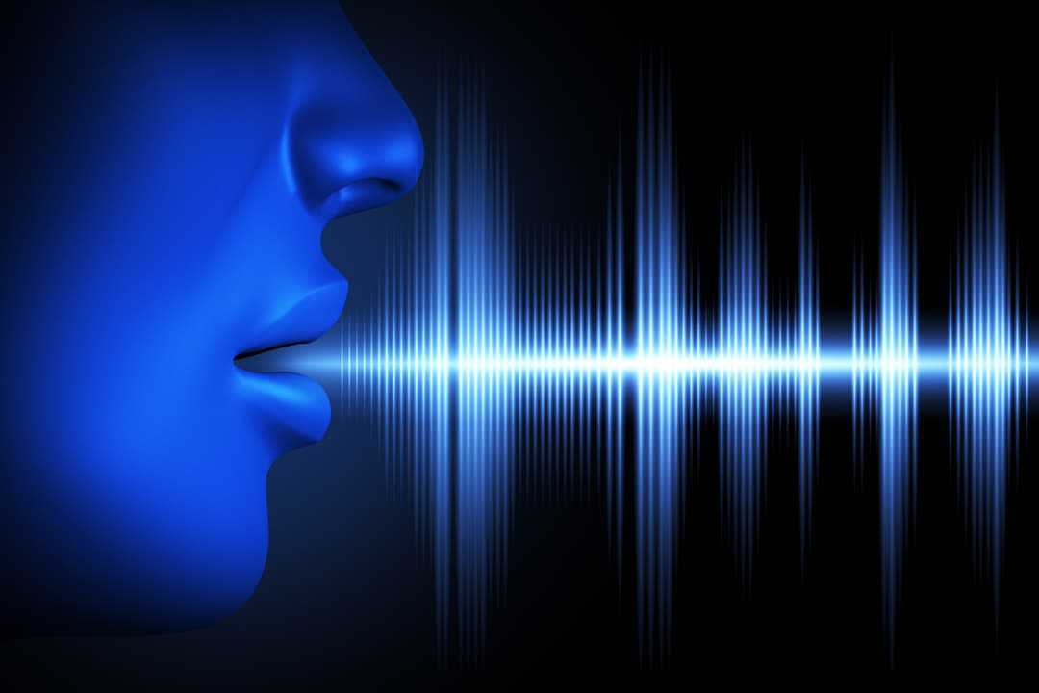
PREDICTION OF PARKINSON DISEASE USING SPEECH SIGNALS
PROJECT GUIDE:
MRS. DEEPA P
TEAM MEMBERS:
MADHUMITHA B D(2018PECCS159)
KEERTHIKA S(2018PECCS152)
HARSHINI C(2018PECCS137)
BATCH: DOMAIN:
A14 DEEP LEARNING

Slide 2

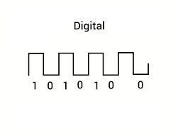


SYSTEM ARCHITECTURE
DATA-PREPROCESSING
AUDIO SIGNAL
FEATURE EXTRACTION
DEEP LEARNING ALGORITHM
DATA-PREPROCESSING
AUDIO SIGNAL
FEATURE EXTRACTION
HEALTHY
PARKINSON
MILD-PARKINSON

Slide 3
SYSTEM DESIGN
E-R Diagram
UML Diagrams
Input design

Slide 4
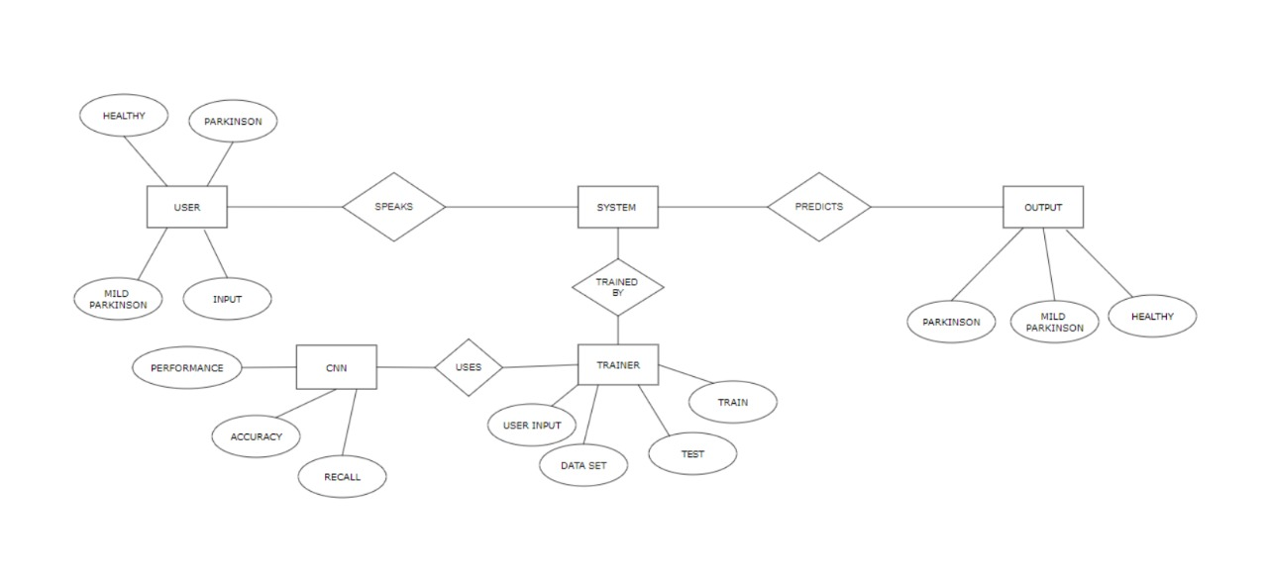
E-R DIAGRAM

Slide 5
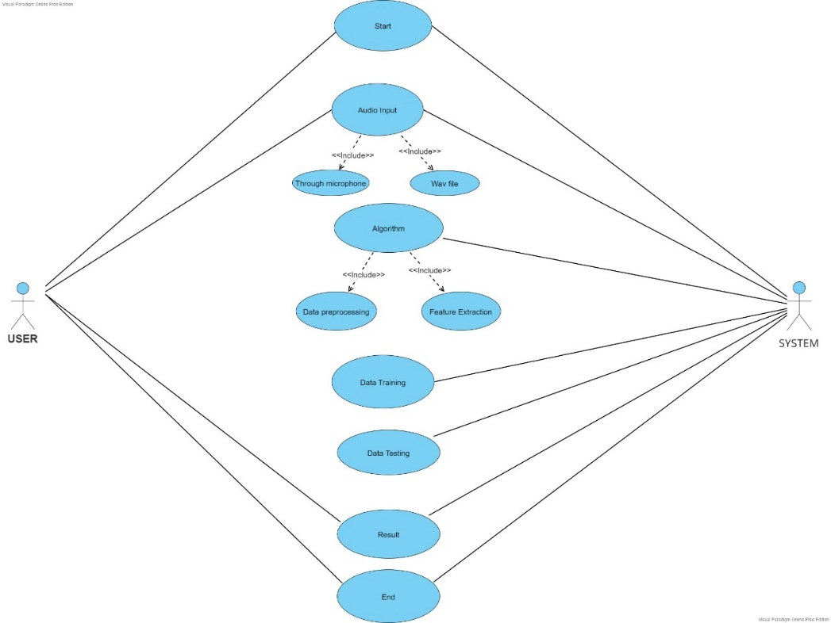
UML DIAGRAMS (USECASE DIAGRAM)

Slide 6
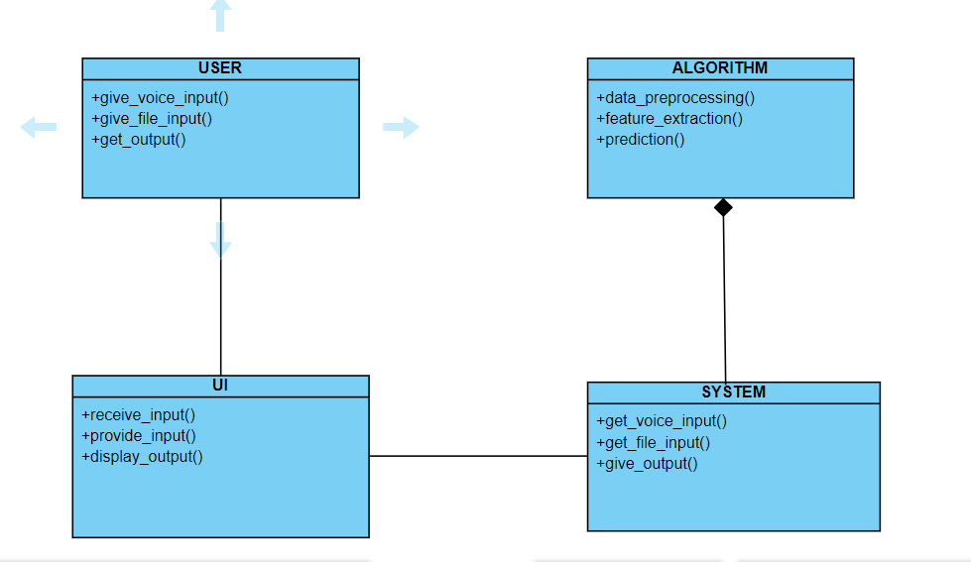
CLASS DIAGRAM

Slide 7
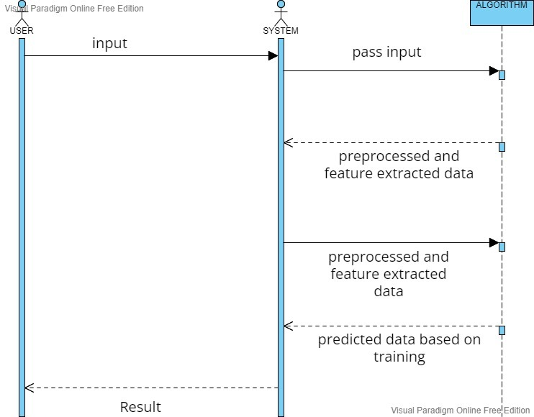
SEQUENCE DIAGRAM

Slide 8
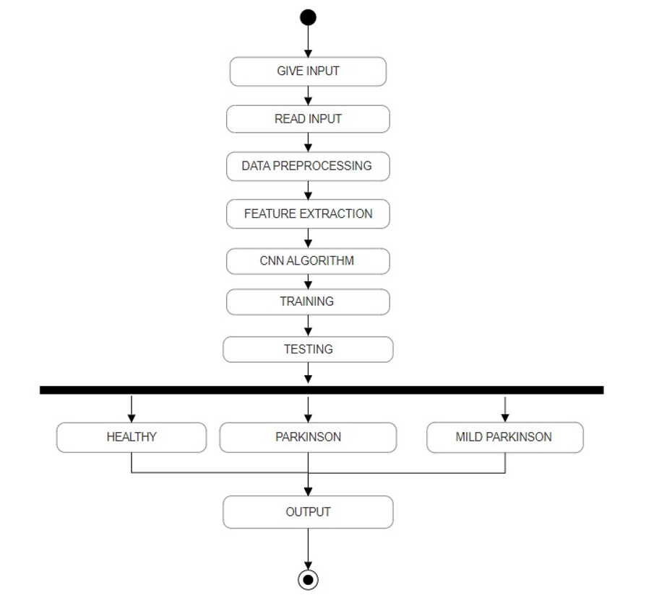
ACTIVITY DIAGRAM

Slide 9
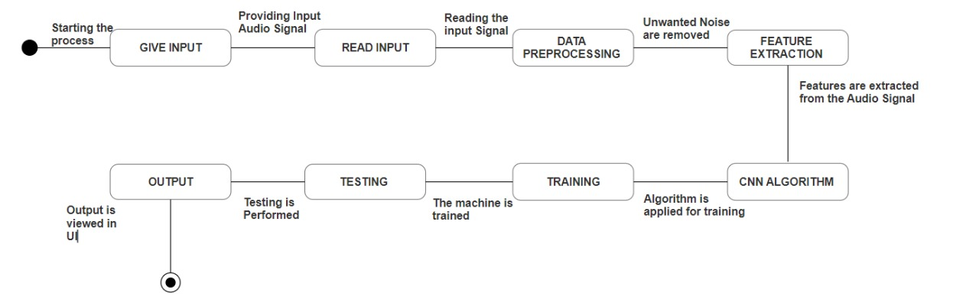
STATE CHART DIAGRAM

Slide 10
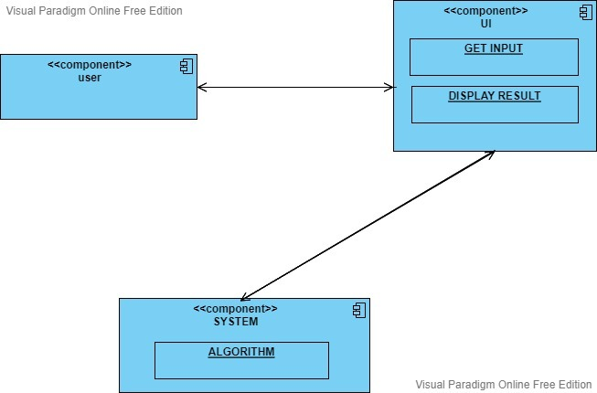
COMPONENT DIAGRAM

Slide 11
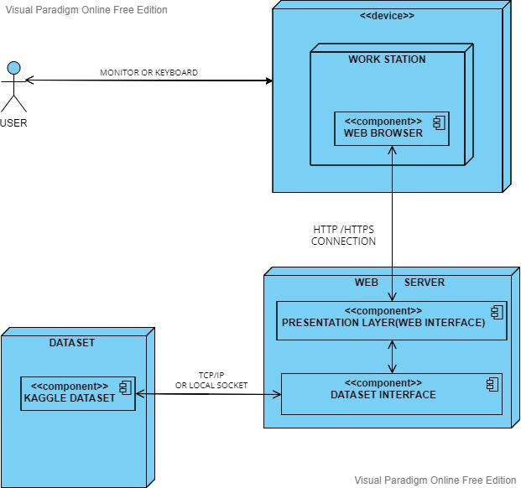
DEPLOYMENT DIAGRAM

Slide 12
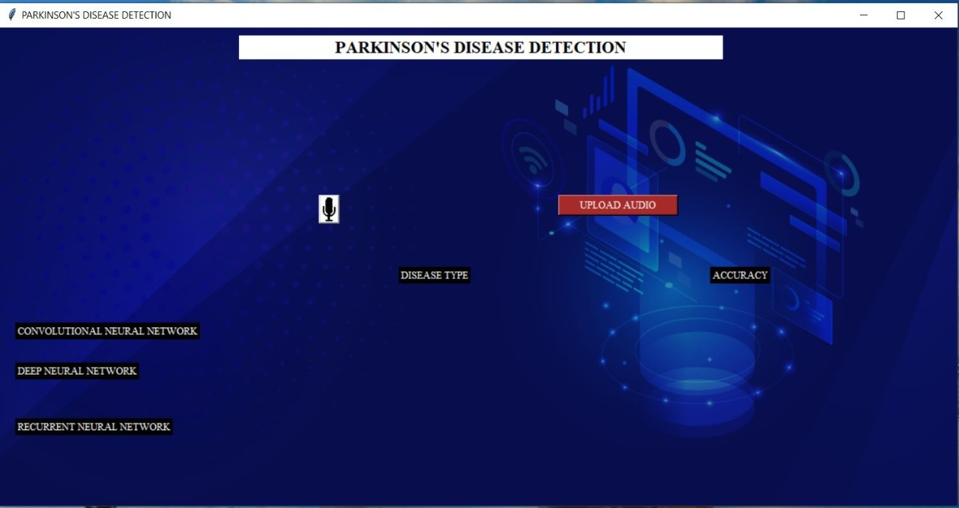
INPUT DESIGN

Slide 13

LIVE AUDIO INPUT

Slide 14
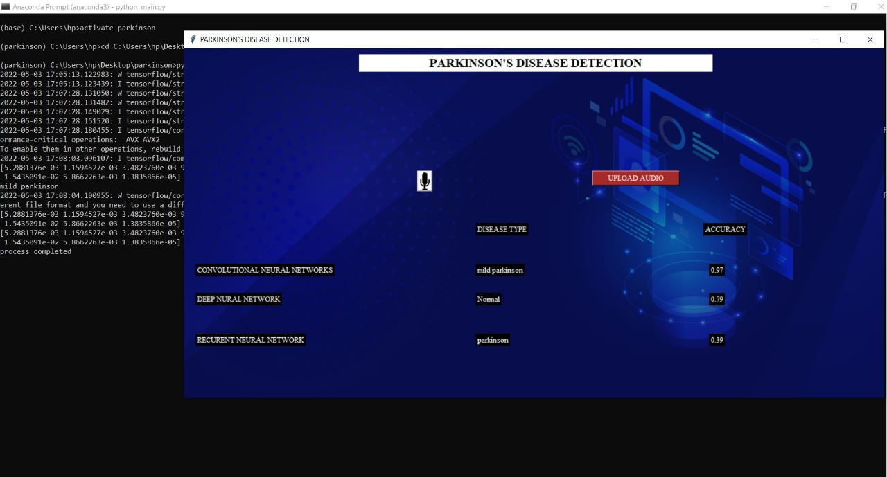
DATASET AUDIO INPUT

Slide 15
MODULES
Data Pre-Processing
Feature Extraction
Classification
Training
Testing

Slide 16
DATA PRE-PROCESSING
Data preprocessing is an important step in prior to data feature extraction analysis.
In this step , a primary microphone is used through which the patients voice is recorded for analysis.
The Recorded voice signal retrieved from the patient is converted from analog to digital signal.

Slide 17
FEATURE EXTRACTION
Feature selection is the process of selecting a subset of relevant features for use in model construction.
It is also known as variable selection, attribute selection or variable subset selection.
Different voice features such as frequency , amplitude are extracted from digital voice signal obtained from the patient.
Based on these vocal features , diagnosis of Parkinson’s disease is performed.

Slide 18
CLASSIFICATION
In Deep learning , classification is the problem of identifying to which of a set of categories a new observation belongs, on the basis of a training set of data containing observations whose category membership is known.
Based on the feature selection which is done prior to classification, the patients are classified as Healthy , Mild Parkinson and Parkinson.

Slide 19
TRAINING
Training
The voice dataset of Parkinson affected person and healthy person is collected from kaggle .
The collected voice dataset is preprocessed and features like frequency, amplitude are extracted.
Based on the features extracted the model is trained.

Slide 20
TESTING
Testing
The voice of the user is collected from user interface.
The collected voice is preprocessed and required features like frequency,amplitude are extracted from the voice.
Based on the trained data ,the system test the feature extracted and predicts the health status of person such as Healthy, Mild Parkinson and Parkinson.

Slide 21
ALGORITHM EXPLANATION
Convolutional Neural Network:
In deep learning, a convolutional neural network (CNN/ConvNet) is a class of deep neural networks, most commonly applied to recognize speech performance.
It consist of single or more than one layer,CNN can do lot of things when they are fed with bunch of signals as input to it.
Initially audio signal is converted into wave file then the data is preprocessed where numerical data required for the prediction is extracted from the signal.
This numerical data array is reshaped according to the requirements of predicting the voice .

Slide 22
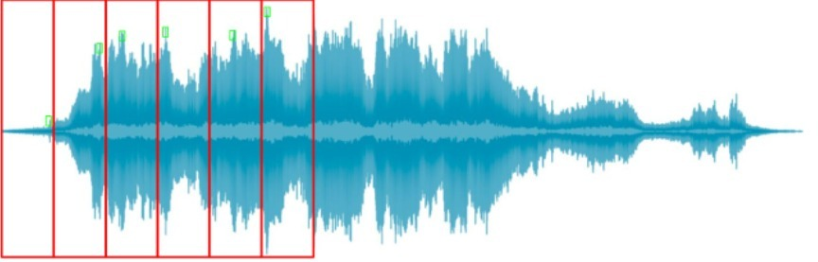
ALGORITHM EXPLANATION
The preprocessed data will be loaded to the model for prediction .
Finally the output is obtained based on the trained model.

Slide 23
THANK YOU

